Slide 1


What can mutational signatures tell us about the causes of cancer?
Steven G. Rozen
steverozen@pm.me
August 22, 2023
臺北榮總腫瘤醫學部
Taipei Veterans General Tumor Hospital
https://github.com/Rozen-Lab/msigs
Notes:
25 minute talk

Slide 2




Thank you for sponsoring my visit
| Graduate Institute of Biomedical Sciences
Dean Chun-Yen Lin 林俊彥教授, Dean of College of Medicine, CGU
Professor Ming-Ling Kuo 郭敏玲教授, Director, Graduate Institute of Biomedical Sciences, CGU
Dr Ian Y. F. Zhang 張益峯, Molecular Medicine Research Center, CGU

Slide 3
Outline
Background on mutational signatures
Many East Asian lung cancers in smokers do not have mutations due to smoking
AA (aristolochic acid, 馬兜鈴酸) and liver cancer

Slide 4
Outline
Background on mutational signatures
Many East Asian lung cancers in smokers do not have mutations due to smoking
AA (aristolochic acid, 馬兜鈴酸) and liver cancer

Slide 5
A quick review on somatic mutations
Every time our cells divide, mutations arise
Mutations not present in the fertilized egg are somatic mutations
We will mostly focus on somatic mutations

Slide 6
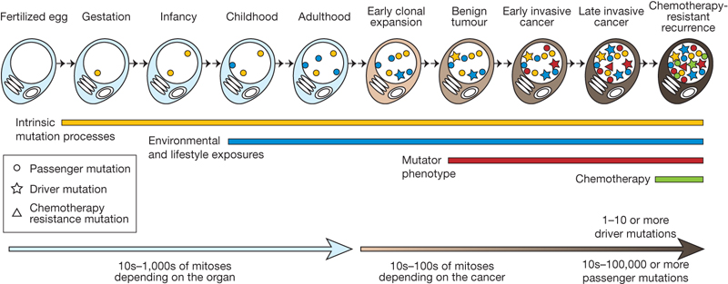
We detect somatic mutations by DNA sequencing normal cells and tumour cells
Normal
Normal
…ACGTCCTAGTCAAAATCGAGCC…

Slide 7
We detect somatic mutations by DNA sequencing normal cells and tumour cells
and tumor cells
Normal
Tumor
…ACGTCCTAGTCAAAATCGAGCC…
…ACGTCCTAGTCTAAATCGAGCC…

Slide 8
We usually detect somatic mutations by DNA sequencing normal cells and tumour cells
and tumor cells
We look for the variants found only in the tumor
Normal
Tumor
…ACGTCCTAGTCAAAATCGAGCC…
…ACGTCCTAGTCTAAATCGAGCC…
Somatic mutation from A > T
CAA > CTA
Useful information in neighboring bases

Slide 9
Concept of “mutational signature”
Examine mutation patterns in a tumor (or other tissue) to infer mutational exposures or processes that led to the mutations
We will focus on *somatic* mutations in cancer
There can be different types of mutation patterns
But we will focus on single base mutations in the context of preceding and following bases

Slide 10
We usually detect somatic mutations by DNA sequencing normal cells and tumour cells
and tumor cells
We look for the variants found only in the tumor
Normal
Tumor
…ACGTCCTAGTCAAAATCGAGCC…
…ACGTCCTAGTCTAAATCGAGCC…
Somatic mutation from A > T
CAA > CTA
Useful information in neighboring bases

Slide 11
We look at all mutations from whole genome or whole exome sequencing (most are not causing the cancer; they are innocent bystanders)
We want to know: what processes mutated the DNA?
?

Slide 12
We look at all mutations from whole genome or whole exome sequencing (most are not causing the cancer; they are innocent bystanders)
We want to know: what processes mutated the DNA?
Later we can think about what the mutations tell us about the causes of cancer
?

Slide 13
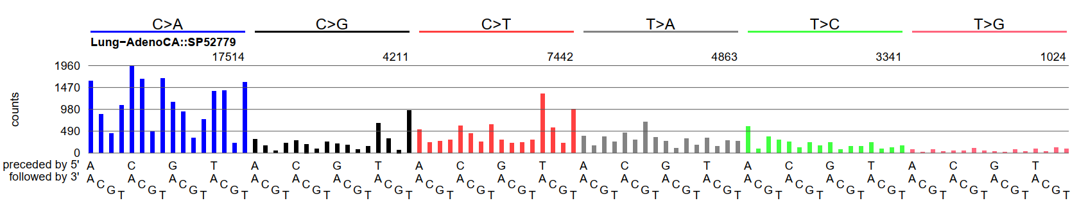
Example mutational spectrum
This graph shows the numbers of single base mutations in the contexts of preceding and following bases

Slide 14
Example mutational spectrum
This graph shows the numbers of single base mutations in the contexts of preceding and following bases
This is from a lung adenocarcinoma with lots of mutations caused by smoking

Slide 15
Example mutational spectrum
CTG to CAG mutations
~630 mutations
Highest blue bar represents the number of CCA to CAA mutations across the entire genome
The higher the bar, the more CCA to CAA mutations
1,960 mutations
Highest red bar = the number of TCA to TTA mutations across the entire genome;
~1,350 mutations

Slide 16
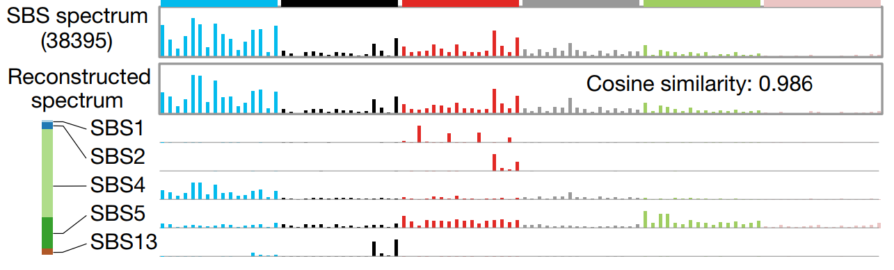
A mutational spectrum is the sum of mutations due to several mutational signatures
Alexandrov, …., Rozen, Stratton, 2020, 10.1038/s41586-020-1943-3 cited > 2000 times

Slide 17
We used computational data mining techniques to analyze mutations from 23,000 tumors to generate a “reference set” of approximately 50 mutational signatures
Many signatures are also supported by experiments (for example by exposing cultured cells to mutagens)
Computational tools for data mining are not perfect (e.g. variation depending on other spectra in the set)
Nevertheless, reference set of signatures very useful
Updated reference set (maintained by Ludmil Alexandrov) is at COSMIC https://cancer.sanger.ac.uk/signatures/

Slide 18
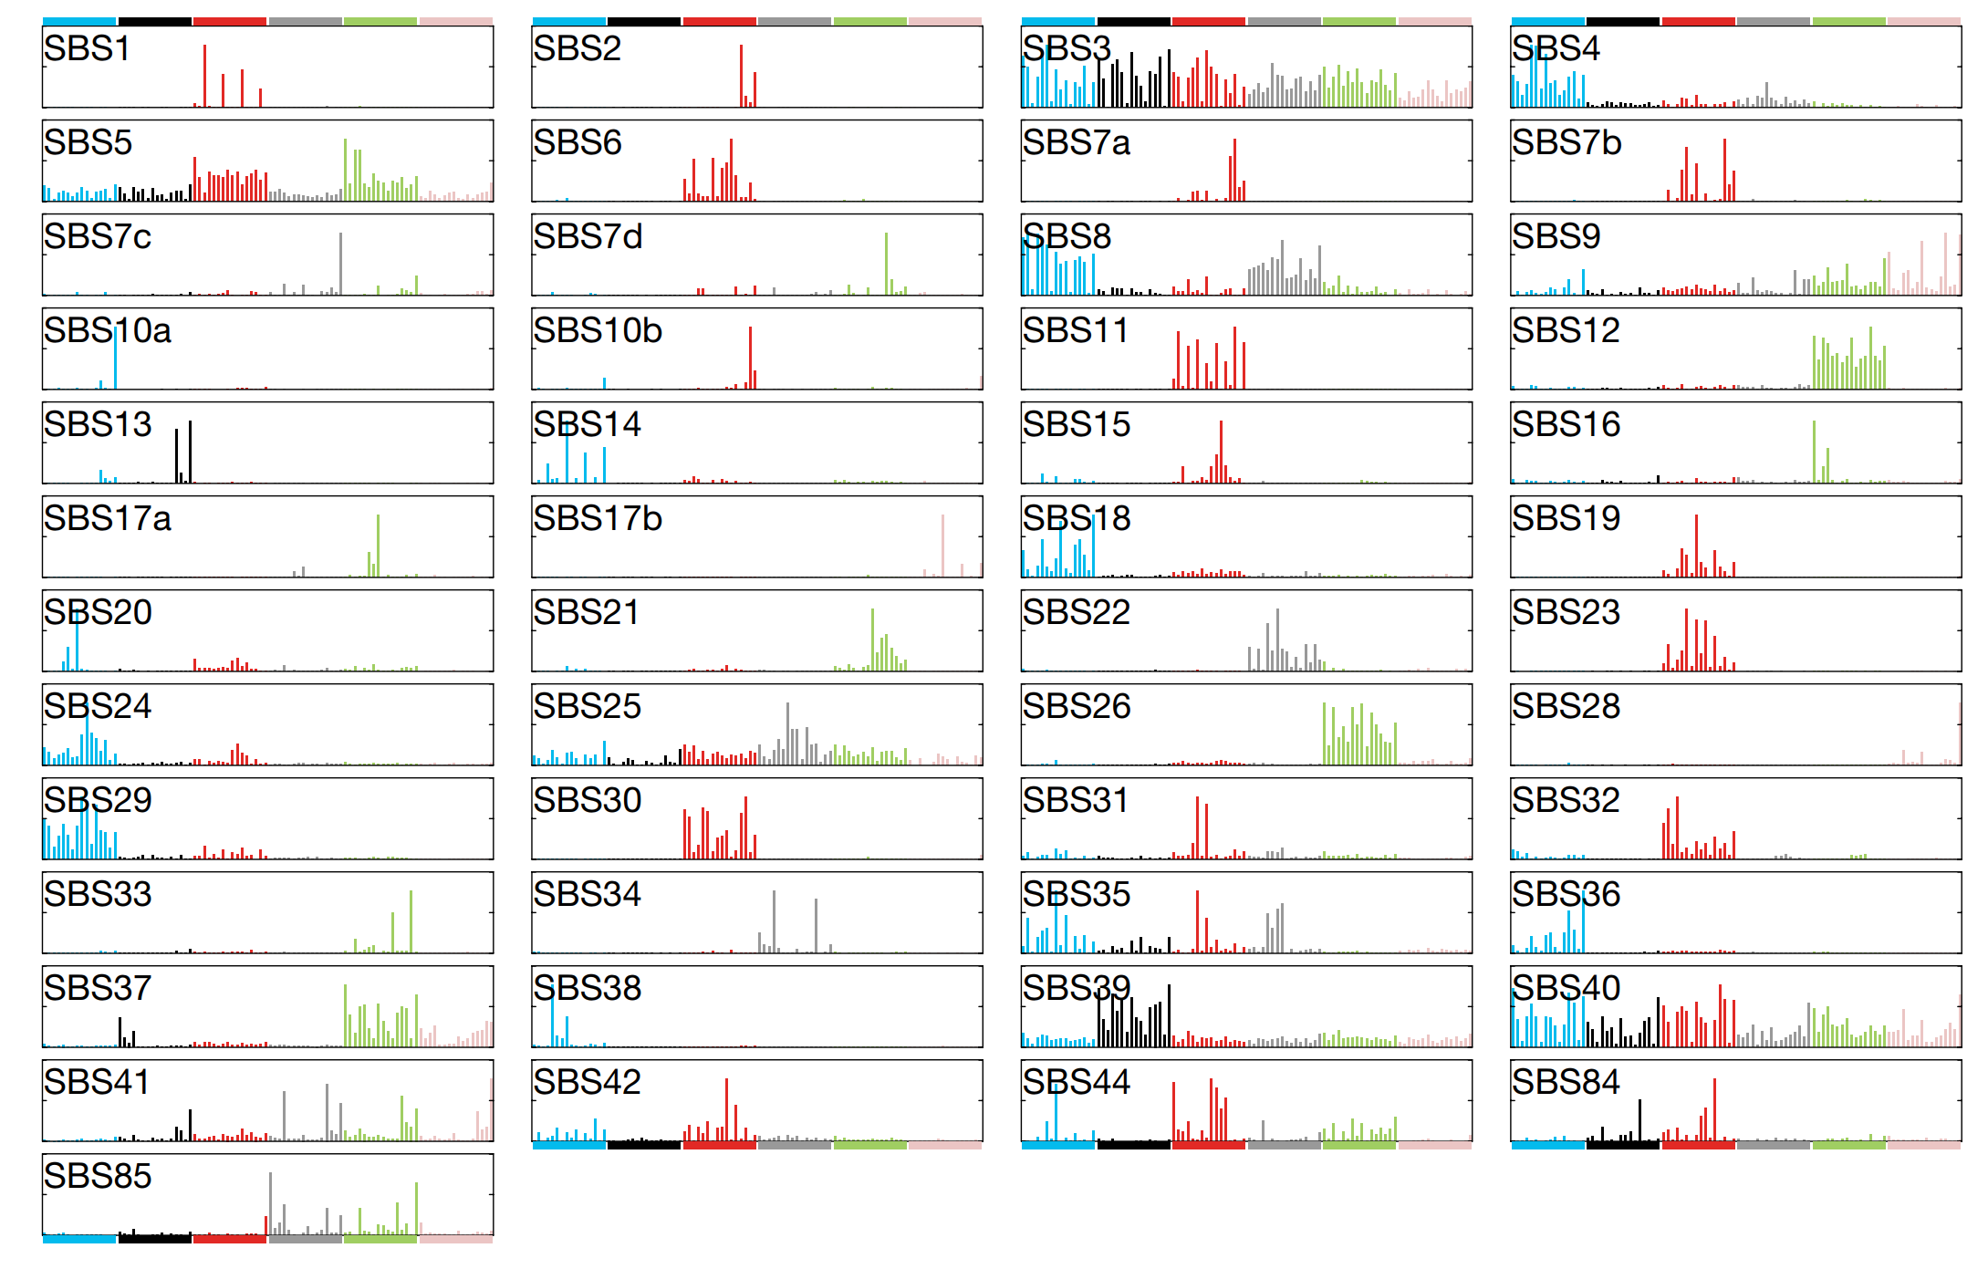
Reference set of signatures mined from 23,000 tumors -- paper cited > 2000 times since 2020
Alexandrov, …., Rozen, Stratton, 2020, 10.1038/s41586-020-1943-3

Slide 19
Outline
Background on mutational signatures
Many East Asian lung cancers in smokers do not have mutations due to smoking
AA (aristolochic acid, 馬兜鈴酸) and liver cancer

Slide 20
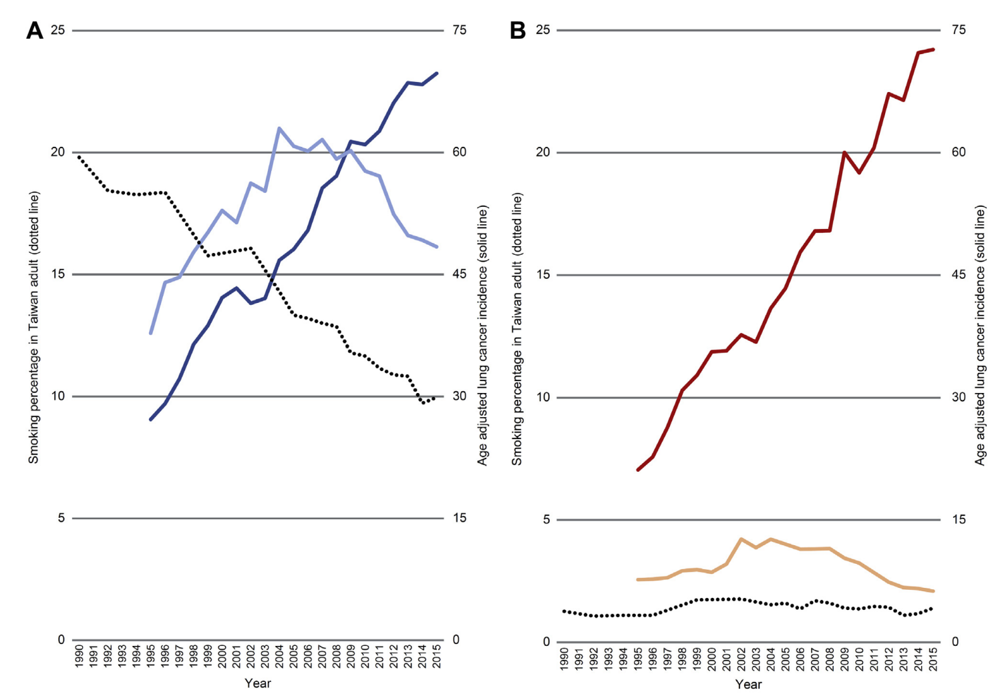
Context: Lung cancer in non-smokers in Taiwan (and East Asia in general) is increasing
Women
25
75
Lung adenocarcinoma
Percent smokers
Age-adjusted incidence (solid line)
Other lung cancer
% smokers
(dotted line)
0
0
1990
2015
Year
Tseng, 2019, doi: 10.1016/j.jtho.2018.12.033

Slide 21
Context: Lung cancer in non-smokers in Taiwan (and East Asia in general) is increasing
Men
Women
25
Lung adenocarcinoma
75
25
75
Lung adenocarcinoma
Other lung cancer
Percent smokers
Age-adjusted incidence (solid line)
Percent smokers
Age-adjusted incidence (solid line)
% smokers
(dotted line)
Other lung cancer
% smokers
(dotted line)
0
0
0
0
1990
2015
1990
2015
Year
Year
Tseng, 2019, doi: 10.1016/j.jtho.2018.12.033

Slide 22
Lung cancer in East-Asian non-smokers
Causes of increasing incidence are unclear (cooking fumes, air pollution, hereditary factors…?)
Oncogenic mutations found in 70% to 90% of lung adenocarcinomas in non-smokers
This is an “oncogene-driven disease”
¹Guo, 2015.

Slide 23
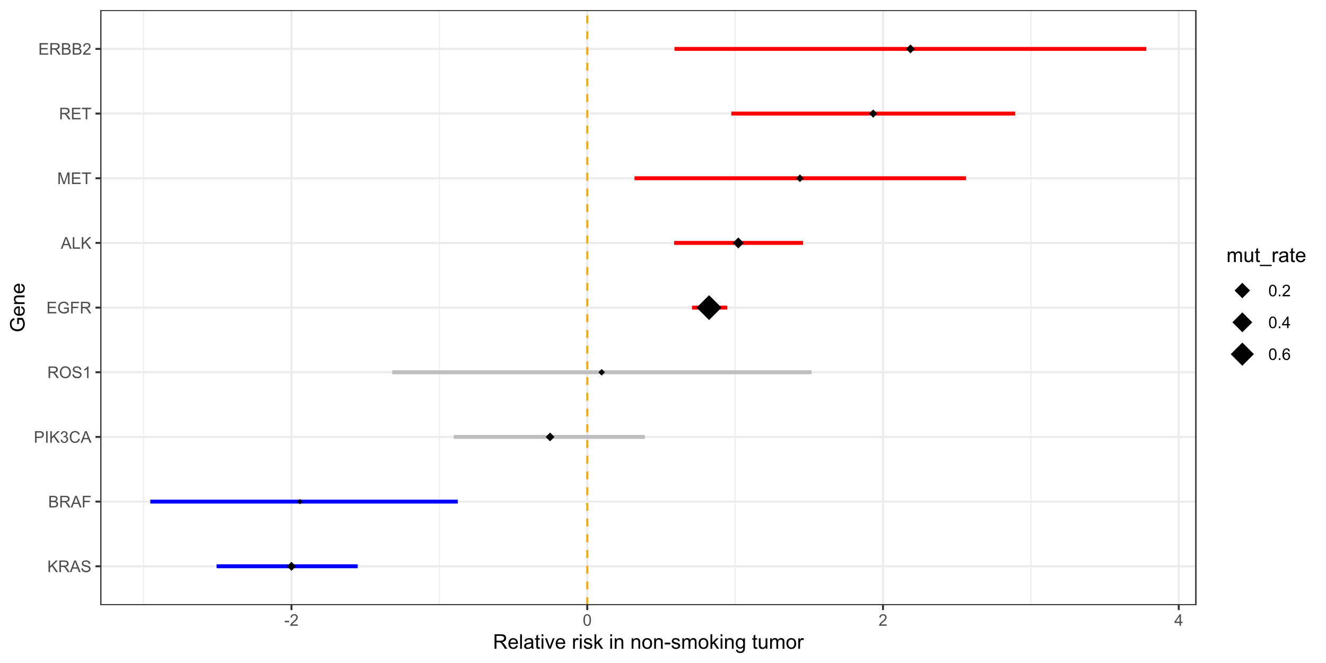
Non-Smoking-Related Oncogenes “NSROs”: oncogenes more frequently mutated in non-smokers
Relative prevalence of oncogene mutations in non-small-cell lung cancers
ERBB2 exon 20 insertion
RET fusion
MET exon 14 skipping
ALK fusion
EGFR exons 18 to 21 mut
ROS1 fusion
PIK3CA mut
BRAF mut
KRAS mut
Definition of NSROs
More prevalent in non-smokers
More prevalent in smokers
Oncogene mutations associated with smoking
-2
0
2
4
Gou, 2015, 10.1002/cncr.29531, Zheng, 10.18632/oncotarget.9541
Log2 of relative prevalence in non-smokers versus smokers

Slide 24

Lung cancers with mutations in non-smoking-related oncogenes (NSRO-driven lung cancers) also occur in smokers
To investigate this common group of tumors…
We studied a total of 173 tumor regions from 48 tumors
We did whole-exome sequencing and categorized the tumors as
NSRO-driven in non-smokers (25)
NSRO-driven in smokers (12)
“Typical smoking” (non-NSRO-driven in smokers, 11)
黃振洋，
Duke-NUS
Chang Gung Memorial Hospital, Linkou
Huang, 2023, 10.1101/2023.07.04.547310

Slide 25
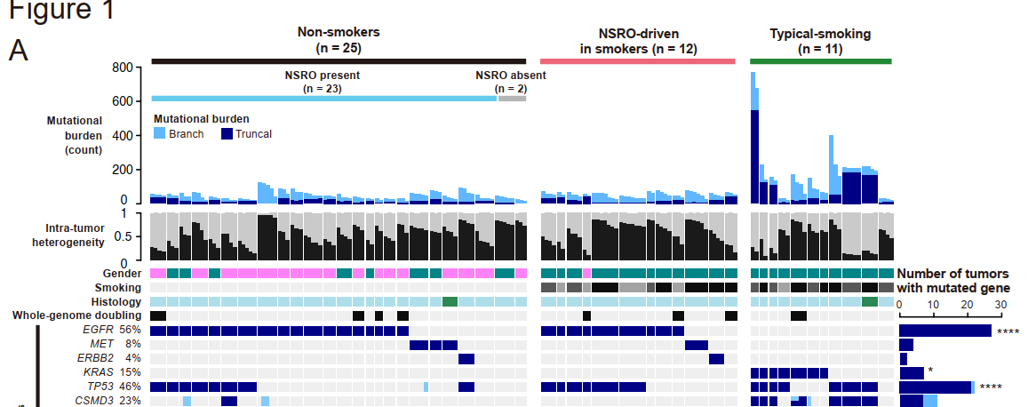
Some genomic characteristics of the 3 groups of tumors
NSRO-driven
in smokers
Typical smoking
NSRO-driven in non-smokers
Number of mutations
Huang, 2023, 10.1101/2023.07.04.547310

Slide 26
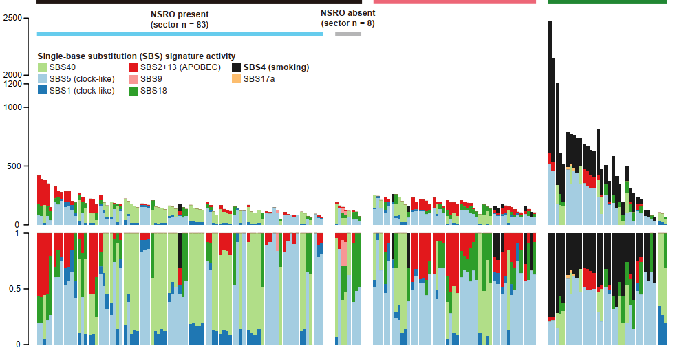
Mutational signature of smoking is absent from NSRO-driven tumors in smokers
NSRO-driven
in smokers
Typical smoking
NSRO-driven in non-smokers
Number of mutations
Proportion of mutations
Huang, 2023, 10.1101/2023.07.04.547310

Slide 27
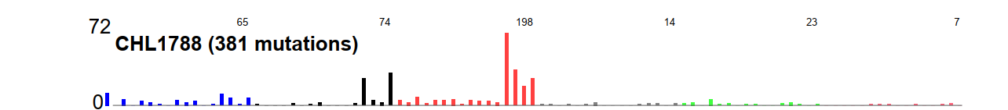
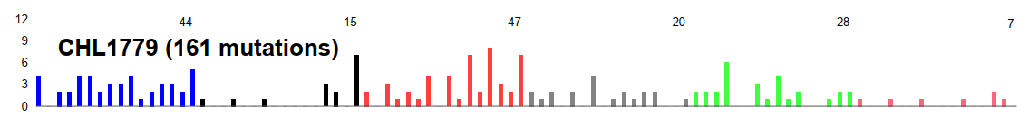
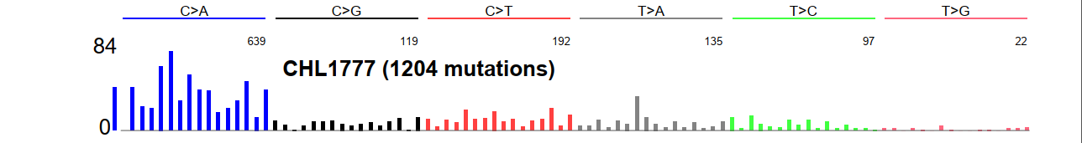
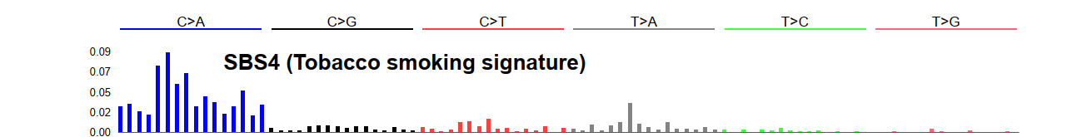
Example mutational spectra
NSRO-driven
in non-smoker
Number of
mutations
Number of
mutations
12
NSRO-driven
in smoker
0
Typical
smoker
Number of
mutations
Pro- portion
of mutations
0.9
Smoking
signature
0
Huang, 2023, 10.1101/2023.07.04.547310
Notes:
Note ABOBEC, slow counts of blue C -> A; blue in CHL1779 is probably from SBS18, maybe ROS related

Slide 28
Unanswered questions about NSRO-driven lung cancer in smokers
Different cell of origin than “typical smoking” tumors?
(Cell of origin escapes tobacco mutations)
Selection against tobacco-mutated cells?
(Once a cell has an oncogenic mutation in an NSRO, tobacco mutations make the cell less fit as a cancer cell)
Does tobacco contribute to oncogenesis in NSRO-driven tumors in smokers through non-mutagenic mechanisms?

Slide 29
Outline
Background on mutational signatures
Many East Asian lung cancers in smokers do not have mutations due to smoking
AA (aristolochic acid, 馬兜鈴酸) and liver cancer

Slide 30
Why is AA important?

Slide 31
1990s: AA emerged as a human health problem
~100 young women developed end stage kidney disease
Single weight-loss clinic in Europe
漢防己, hàn fáng jǐ replaced by 廣防己, guǎng fáng jǐ
Notes:
Dose: (Cosyns 2003; Nortier et al. 2000)
Adducts: Nortier et al., 2000

Slide 32
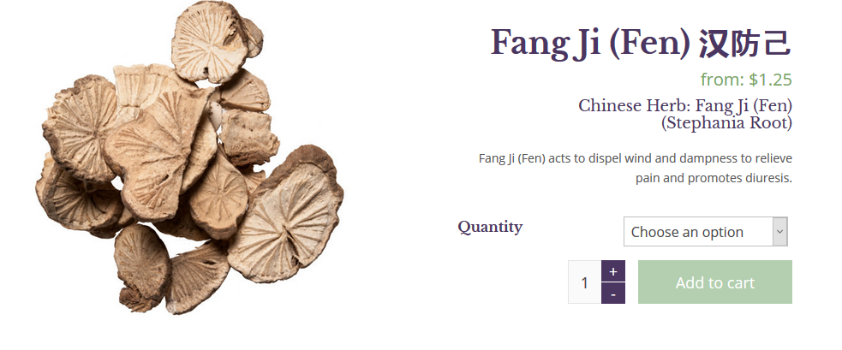
漢防己, hàn fáng jǐ (genus Stephania – no AA)

Slide 33
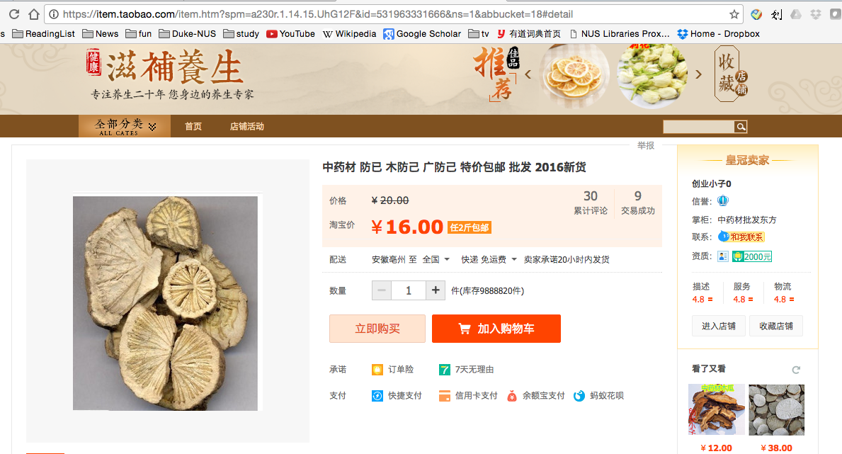
廣防己, guǎng fáng jǐ (genus Aristolochia – has AA)
Notes:
Total of 0.5 g over average of 13 months
AA adducts

Slide 34
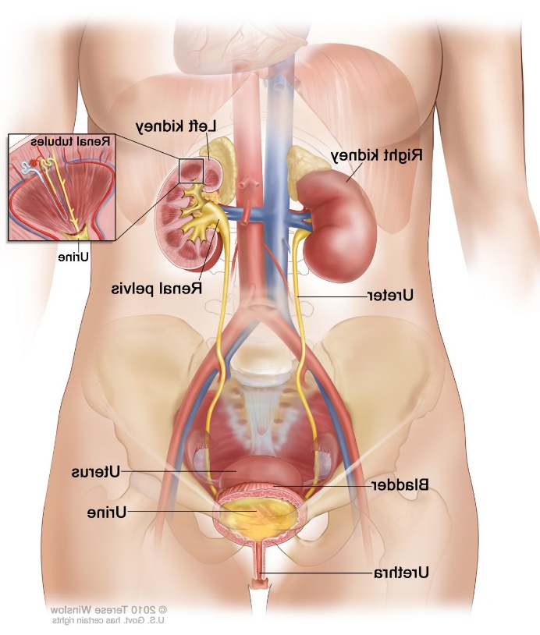
AA identified as a carcinogen:
Many of the AA-kidney-failure victims developed upper tract urothelial cancer
(Nortier et al., 2000, NEJM)

Slide 35
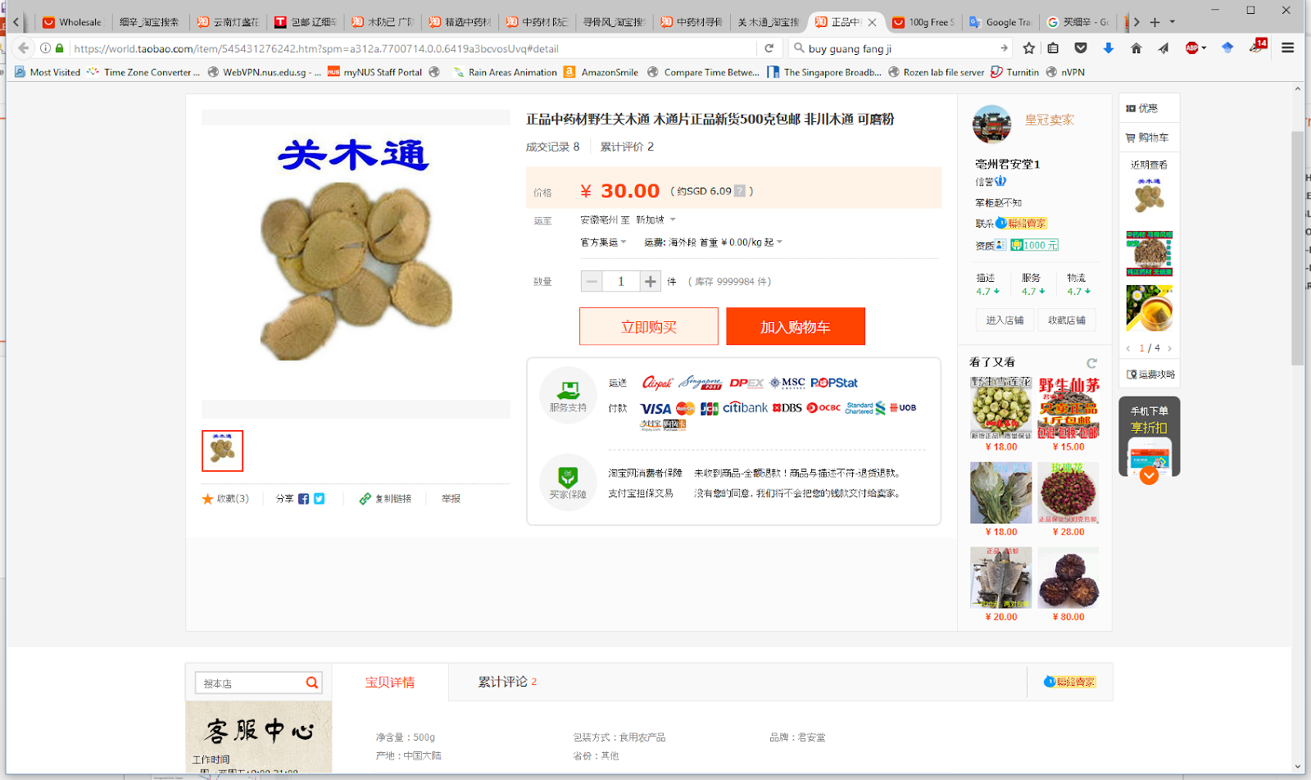
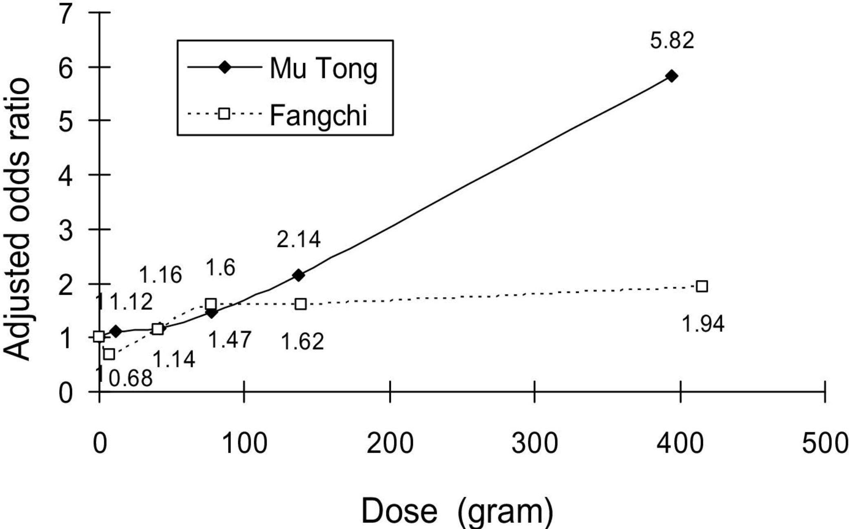
2010: AA-containing herbs cause kidney disease in Taiwan
End-stage renal disease caused by 2 herbs
Adjusted odds ratio for end-stage renal disease
防己
Lai et al, 2010 10.1053/j.ajkd.2009.10.055

Slide 36
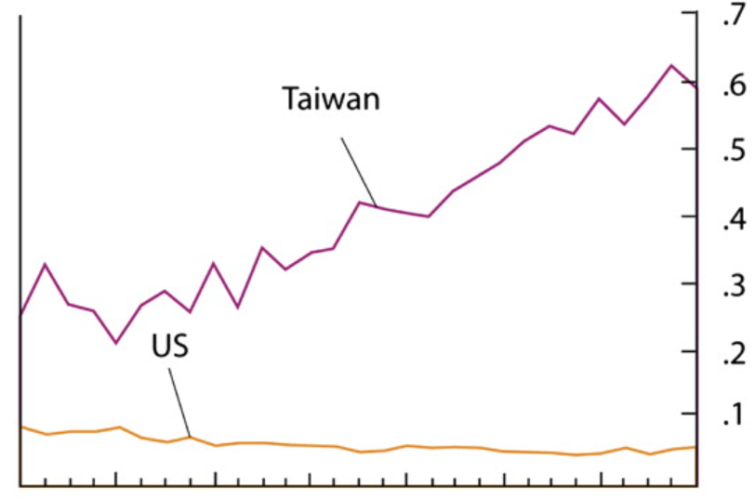
2013 Excess upper tract urothelial cancer versus bladder cancer in Taiwan presumably caused by AA
Incidence ratio of
upper-tract
urothelial cancer
to
bladder cancer
1979
2007
Chen et al, 2012 10.1073/pnas.1119920109

Slide 37

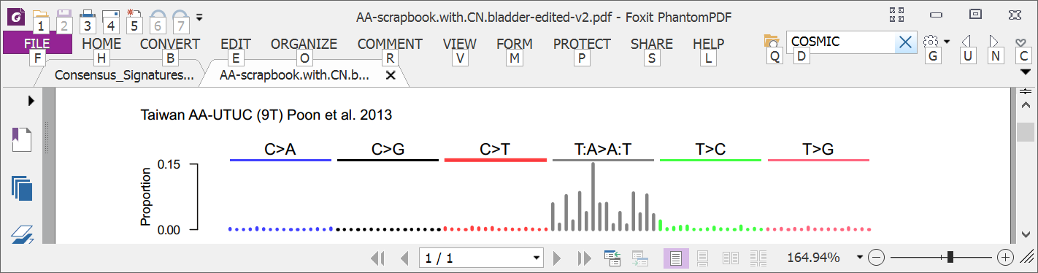
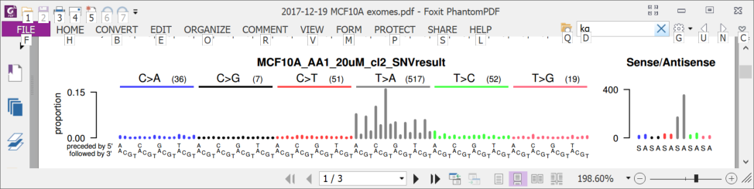
2013: AA mutational signature in upper tract urothelial cancer and cell lines
Songling
Poon
Upper tract urothelial
AA exposed cell line
Poon et al. and Hoang et al. , Science Translational Medicine, 2013

Slide 38
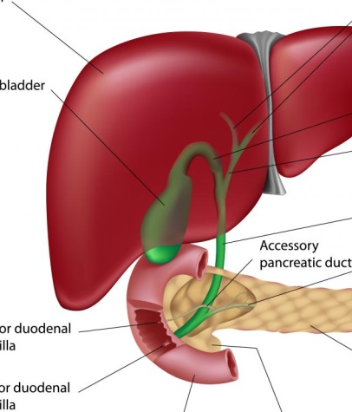
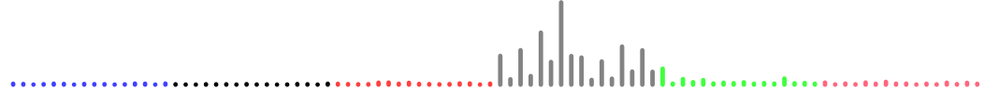
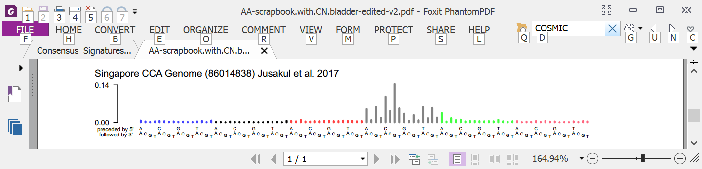
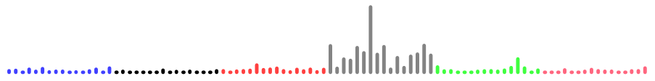
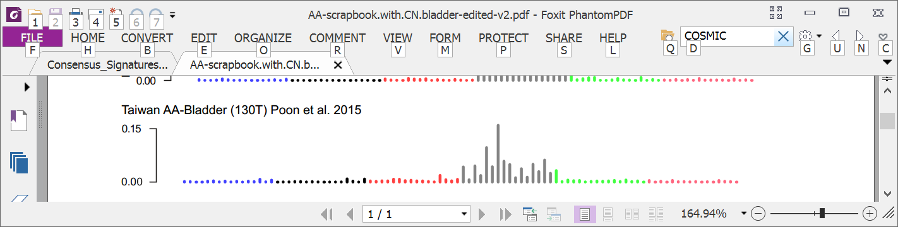
2016: AA mutational signature in multiple tumor types
Liver
Bile duct
Kidney
Upper tract urothelial
Bladder
Poon et al., 2013 and subsequent data (liver - hepatocellular carcinoma [HCC])
Zou et al., 2015, Jusakul et al., 2017 (bile duct carcinoma)
Scelo et al., 2014, Jelakovic et al., 2014 (kidney/renal cell carcinoma)
Poon et al., 2013, Hoang et al., 2013, many others (upper tract urothelial carcinoma)
Poon et al., 2015, others (bladder urothelial carcinoma)

Slide 39

2016: Taiwan a known hotspot for AA kidney failure and AA upper-tract urothelial cancer A good place to investigate AA in liver cancer
Chen, …., Grollman, PNAS, 2012
Map created by Freepik

Slide 40
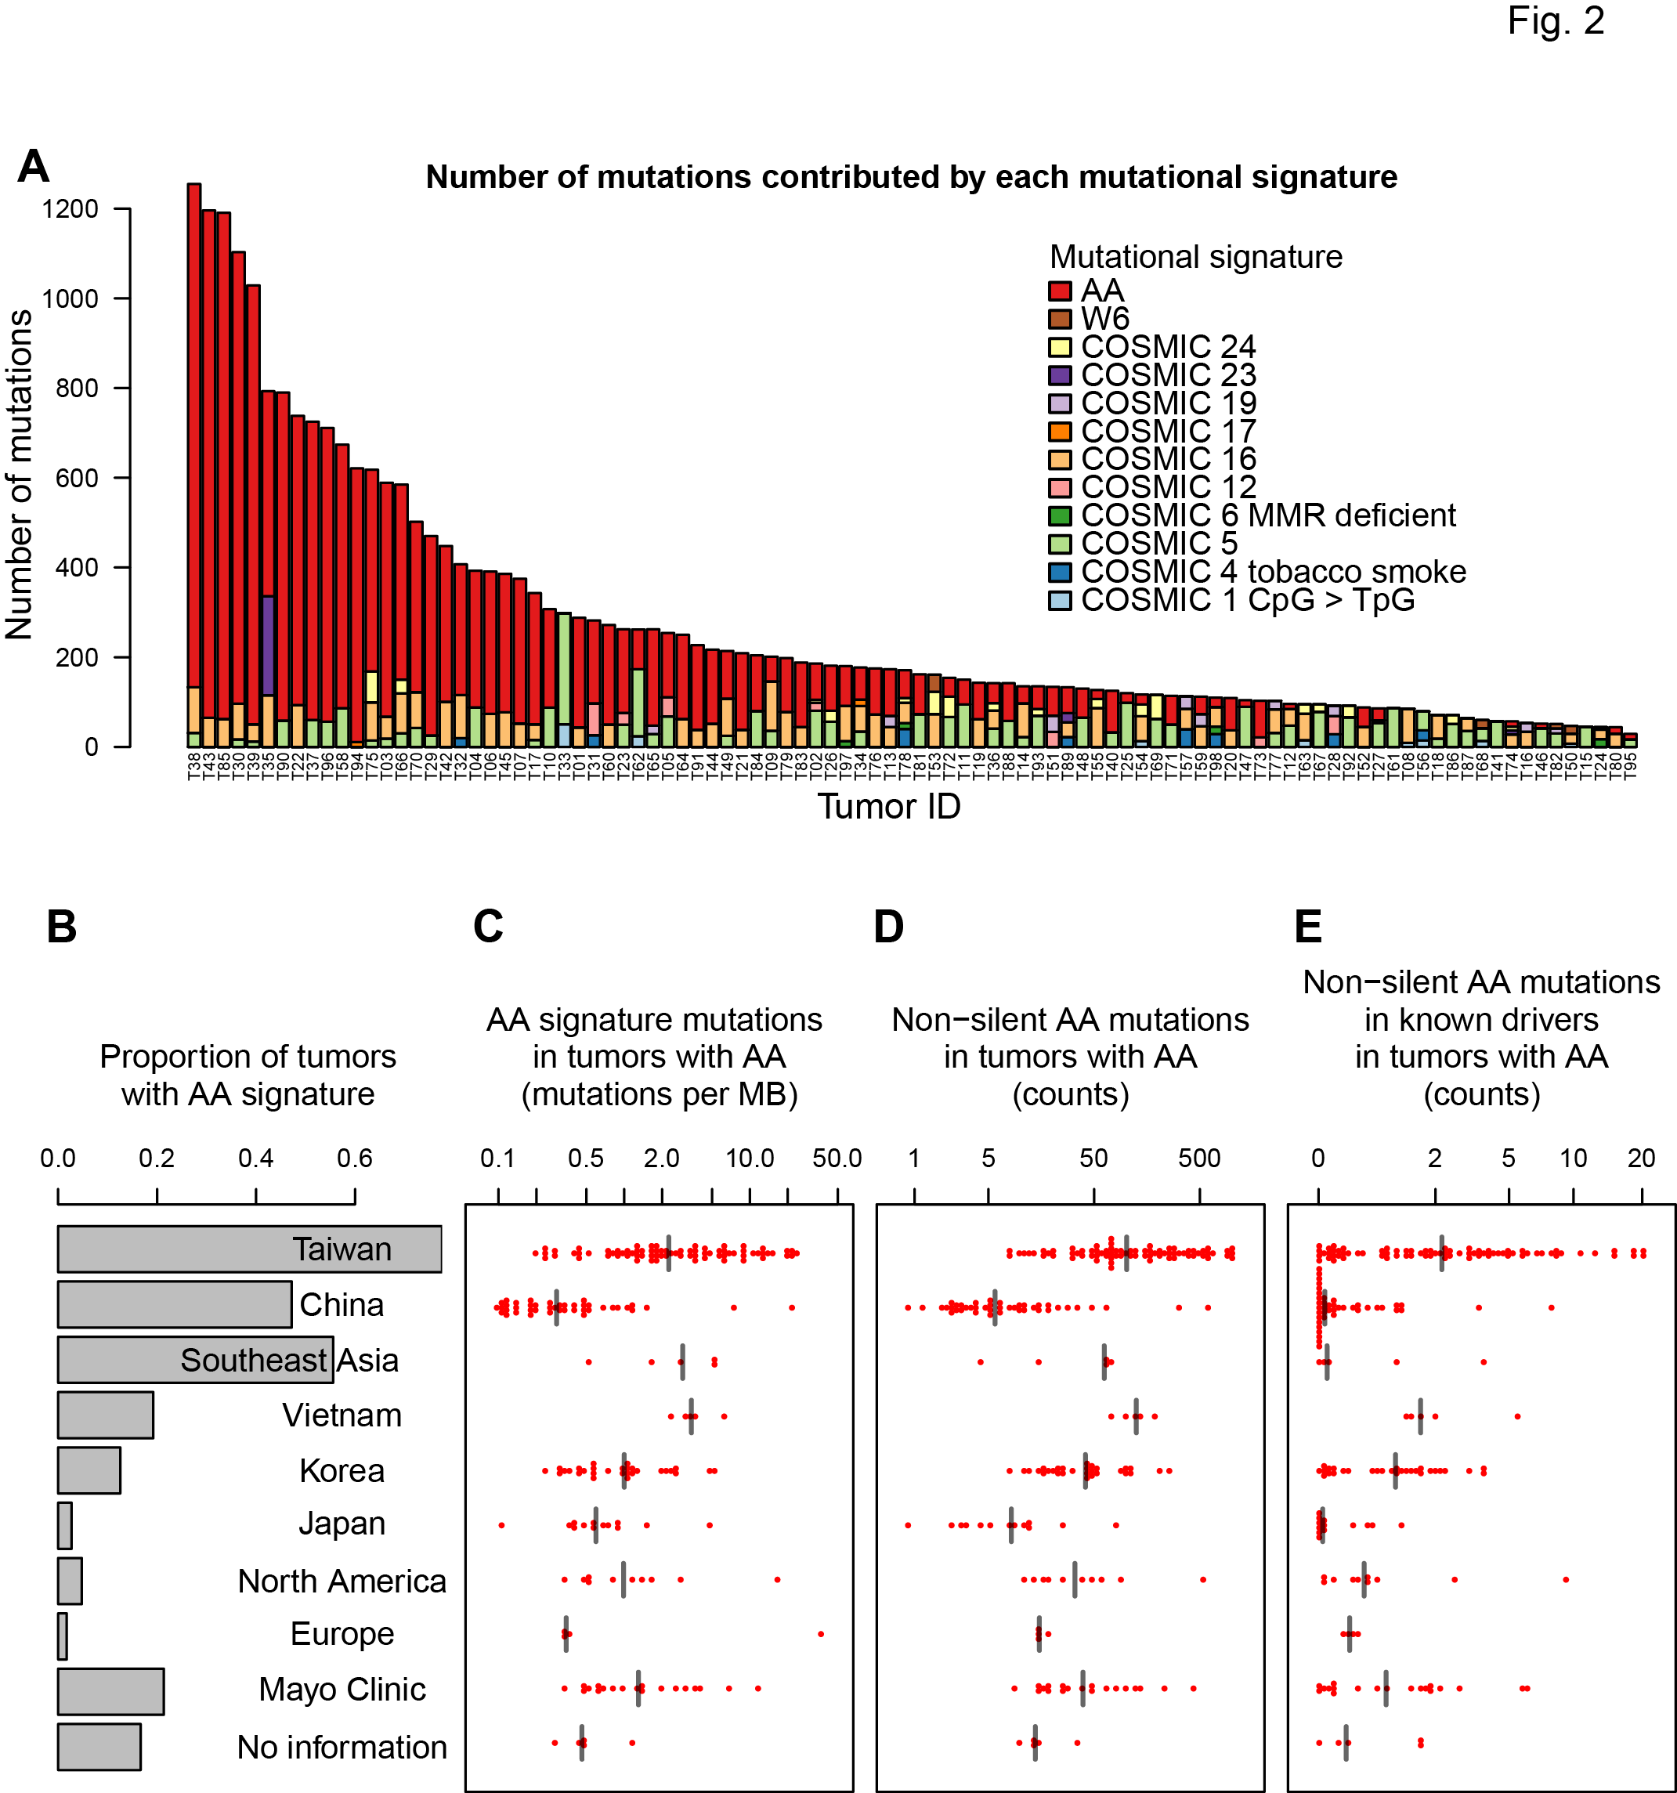
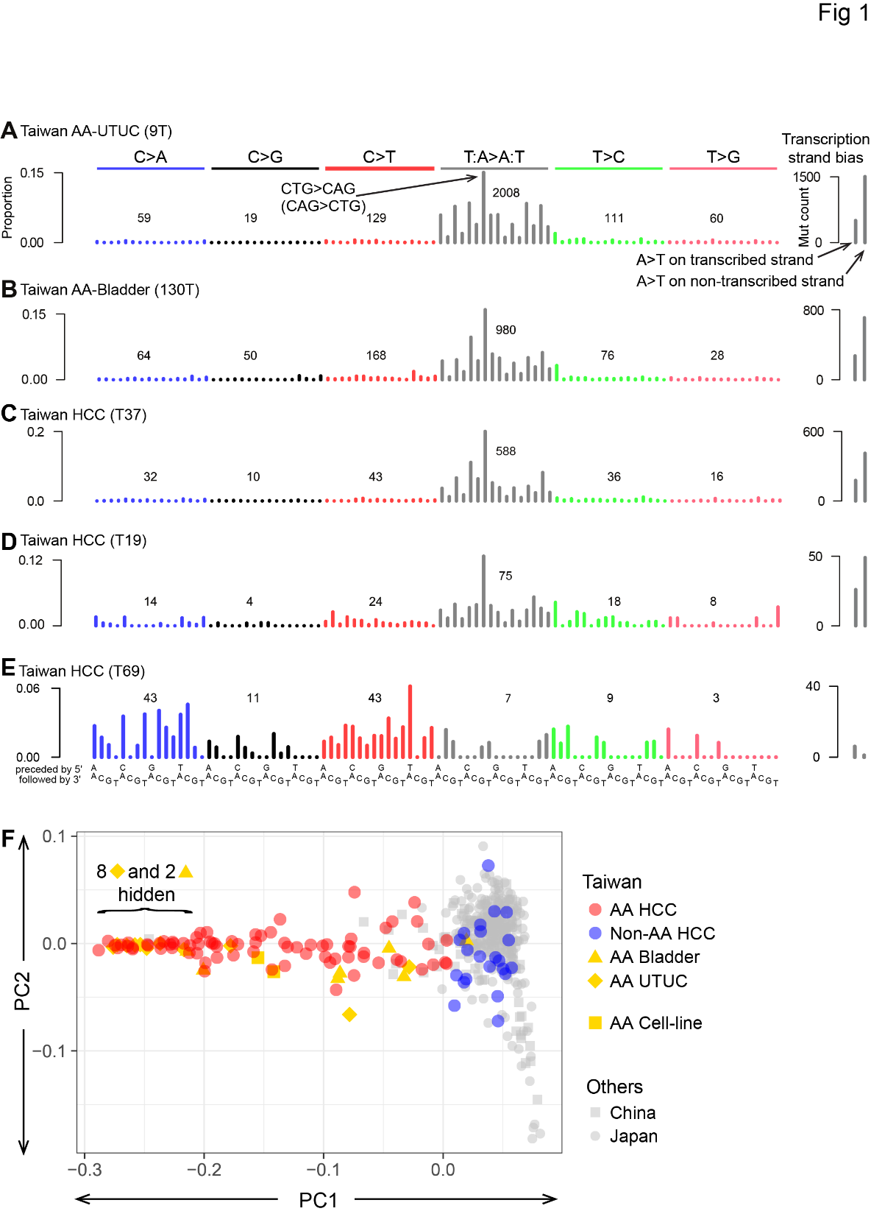
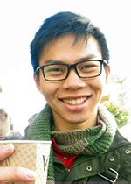
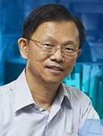
2017: 78% of Taiwan liver cancers (HCCs) had the AA signature (paper from my lab)
Alvin Ng Sen-Yung Hsieh
Red bars show
numbers of
mutations
caused by AA
黄伟添 谢森永
Ng, Poon, et al., Oct 2017 DOI: 10.1126/scitranslmed.aan6446

Slide 41
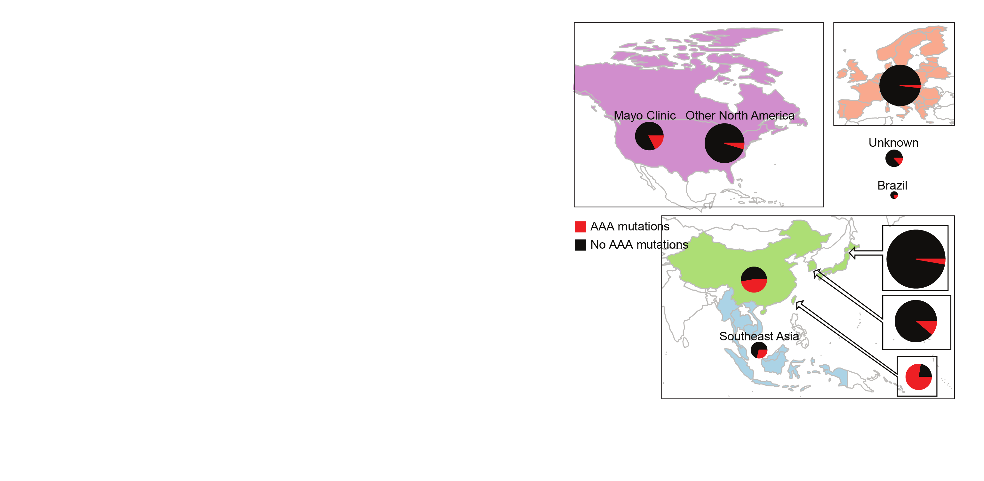
Today: 2,000 liver cancers – AA exposure is prevalent
AA mutations
No AA mutations
“Asian” patients with no “country” – Overseas patients?
Ng, Poon, et al., Oct 2017 DOI: 10.1126/stranslmed.aan6446 and subsequent publications; Zhang et al., 2017, Gastroenterology, 10.1053/j.gastro.2017.03.024; Xue et al., 2019, Cancer Cell,10.1016/j.ccell.2019.04.007, 2021 Unpublished data, 2021

Slide 42
Many AA-exposed liver cancers have multiple known cancer driver genes with AA mutations (as of 2017)
Number of AA mutations
in known driver genes,
per tumor
Taiwan
Mainland China
Other SE Asia
Vietnam
Korea
Japan
North America
Europe
Mayo Clinic
Unknown
Geographical region
Ng, Poon, et al., Oct 2017 DOI: 10.1126/scitranslmed.aan6446

Slide 43
AA can cause liver cancer
AA mutations
No AA mutations
Known mutagen and urinary tract carcinogen
Multiple known cancer driver genes with AA mutations
Linear relationship between AA dose and risk of liver cancer in hepatitis-B-infected and hepatitis-C-infected patients
AA causes liver cancer in mice
“Asian” patients with no “country” – Overseas patients?
Ng, Poon, et al., Oct 2017 DOI: 10.1126/stranslmed.aan6446 and subsequent publications; Zhang et al., 2017, Gastroenterology, 10.1053/j.gastro.2017.03.024; Xue et al., 2019, Cancer Cell,10.1016/j.ccell.2019.04.007; Hsieh et al., 2008, 10.1186/1749-8546-3-13; Chen et al., 2018, International Journal of Cancer, 10.1002/ijc.31544; Chen et al., 2019,Cancer Epidemiology, Biomarkers & Prevention, 10.1158/1055-9965.EPI-19-0023; Lu et al. 2019 Hepatology, 2019, 10.1002/hep.30863

Slide 44
AA conclusions
AA appears to be a widespread problem that for unknown reasons especially affects Taiwan
I propose this needs much more research
Most important question:
How are people being exposed? Is it always herbal medicine? Which herbs? How prepared?

Slide 45
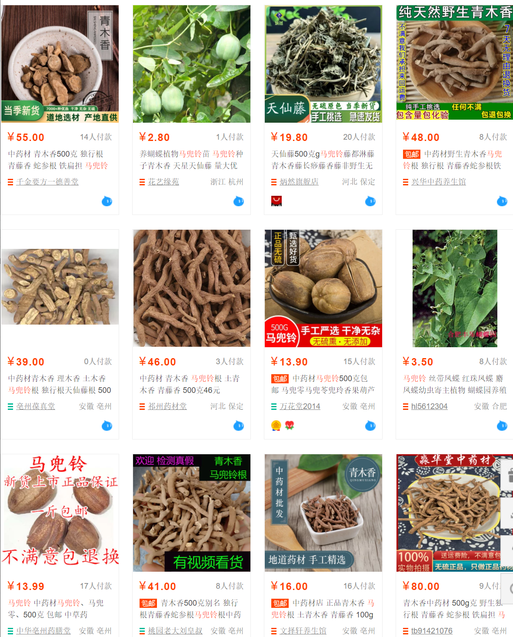
Top results of a search for ma dou ling (马兜铃, Aristolochia contorta or A. debilis) on a popular Mainland shopping web site on 9 July 2021.
Results include seed pods (马兜铃, lower left), roots of the same species (also known as 青木香), and above-ground parts (天仙藤，top row, third from left), and seedlings (top row, second from left).

Slide 46
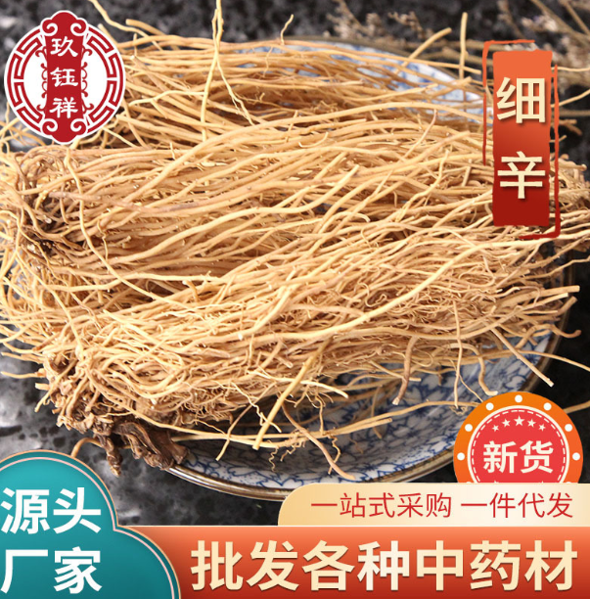
Banned?

Slide 47
AA more questions
What is the dose-risk relationship between AA exposure and liver cancer? Is there interaction with hepatitis?
What is the extent of exposure in India, Africa and Latin America?
What are effective approaches to education and regulation?
Can non-invasive tests (e.g. blood tests) for AA exposure be developed for clinical or research use?
A non-invasive test would enable secondary prevention: exposed individuals might benefit from screening
How to convince funders that prevention is worthy of funding even it will not help anyone who already has cancer?

Slide 48
Overall conclusions – main points
We can use mutational signatures to understand the causes of somatic mutations
When somatic mutation contribute to cancer development, mutational signatures provide insight into the causes of cancer
We talked about 2 examples:
Lack of smoking mutations in NSRO-driven lung cancer even in smokers
Widespread mutagenesis by AA in multiple cancer types (we focused on liver cancer)

Slide 49
Acknowledgements - Funding
Singapore National Medical Research Council
Singapore Ministry of Health via the Duke-NUS Signature Research Programmes
Chang Gung Memorial Hospital (CGMH) Foundation
Chang Gung Medical Foundation
Duke-NUS Khoo Postdoctoral Fellowship Award
United States National Institutes of Health

Slide 50

Acknowledgements
Singapore (Duke NUS, National Cancer Centre Singapore, Genome Institute Singapore, Johns Hopkins Singapore)
Huang Chen-Yang (黃振洋)
Arnoud Boot
Mo LIU (刘陌)
Alvin NG Wei Tian (黄伟添)
Nanhai JIANG (蒋南海)
Shenli Zhang
Szu-Chi Ho
Willie Yu
Cedric C. Y. Ng
Patrick Tan
Bin Tean TEH
Songling Poon
Alex Chang
Daniel Tan
Anders Skanderup
Sen-Yung Hsieh (谢森永)
Jacob See-Tong PANG
Hao-Yi Huang
Ming-Chin Yu
Po-Hung Lin (林柏宏)
Wen-Hui Weng
Ying-Hsu Chang
Kai-Jie Yu,
Kwai-Fong Ng
Ching-Fang Wu
Cheng-Lung Hsu
Cheng-Keng Chuang
Pan Cancer Analysis of Whole Genomes (PCAWG)
Many, including
Ludmil Alexandrov
Mike Stratton
Mi Ni Huang
Jaegil Kim
Gaddy Getz

Slide 51
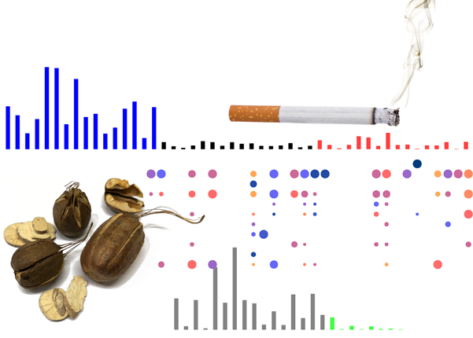
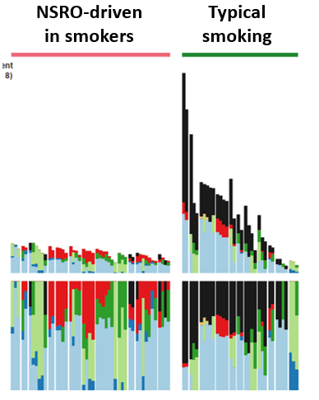
Questions?
Slides at
https://github.com/Rozen-Lab/msigs

Slide 52
Backup slides

Slide 53
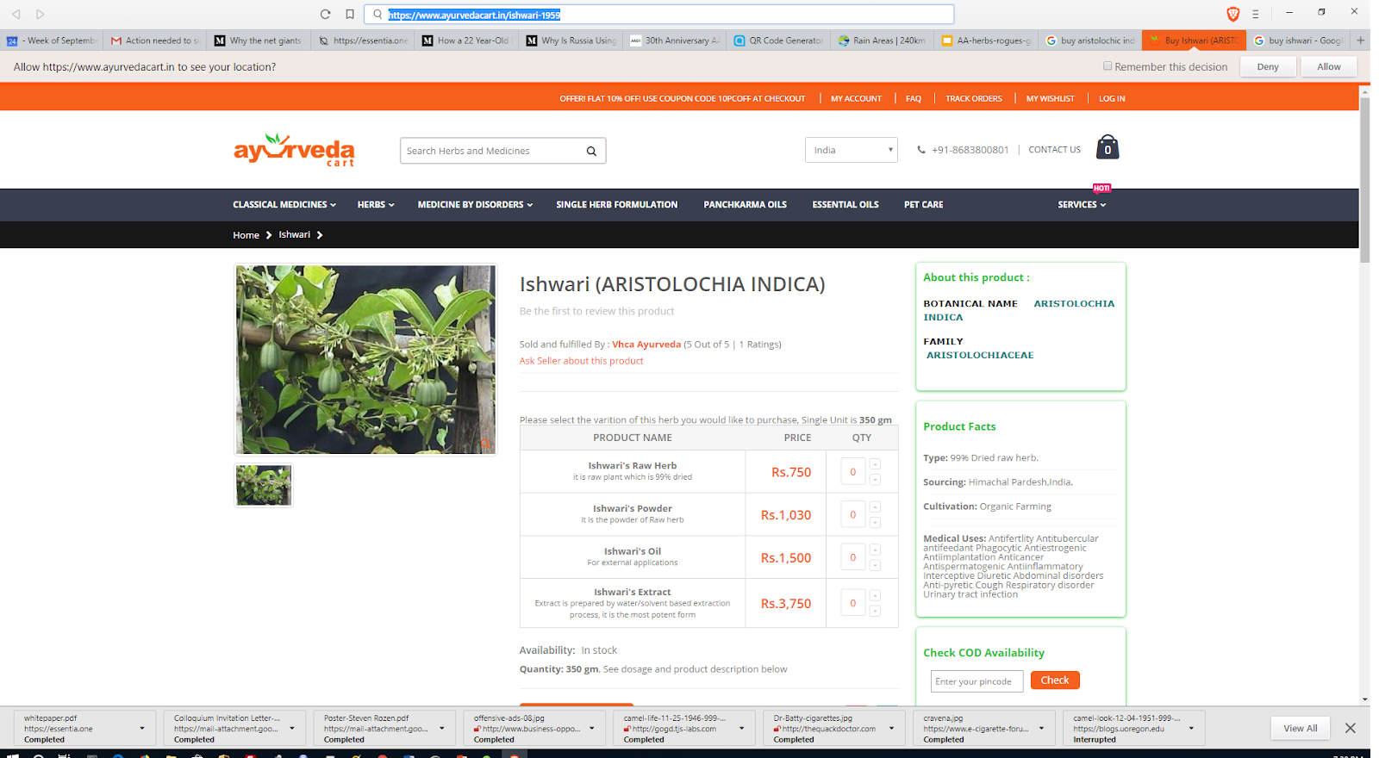
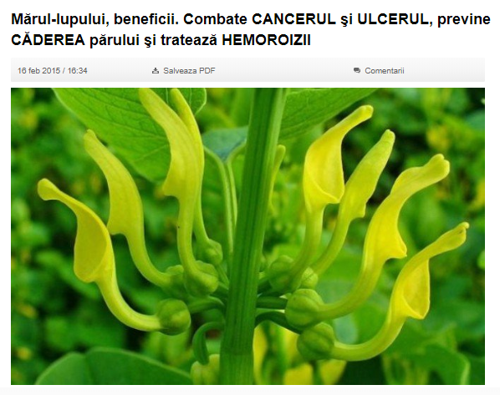
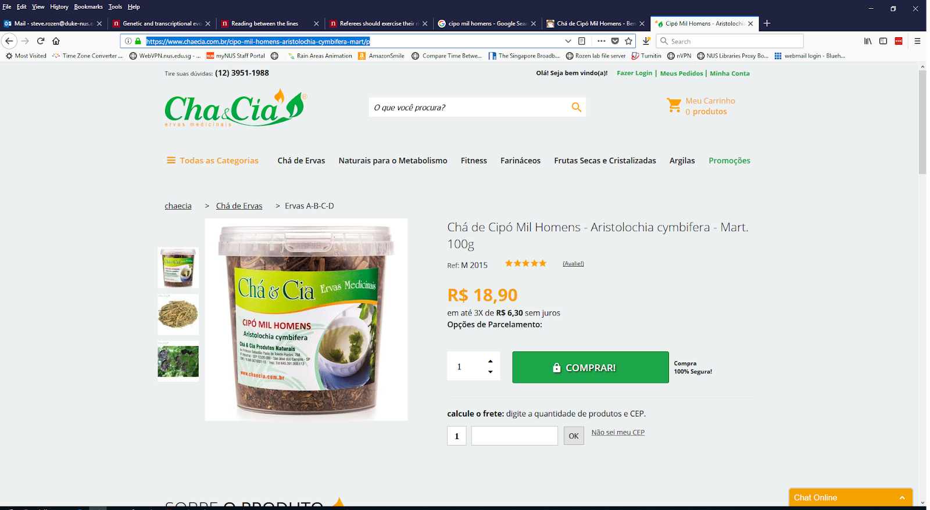
AA is not only an East Asian problem
Romania
India
Aristolochia indica
Brazil
Aristolochia clematitis
Combats cancer, ulcers, prevents hair loss and hemorrhoids
Aristolochia cymbifera

Slide 54
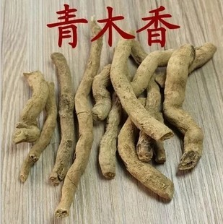
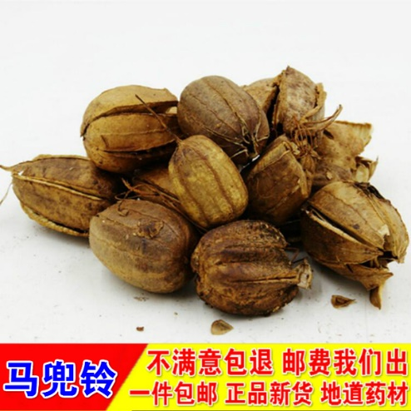
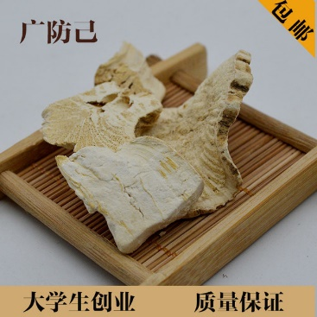
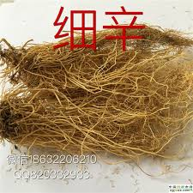
Aristolochic acid (AA) occurs naturally in plants widely used as herbal medicine

Slide 55
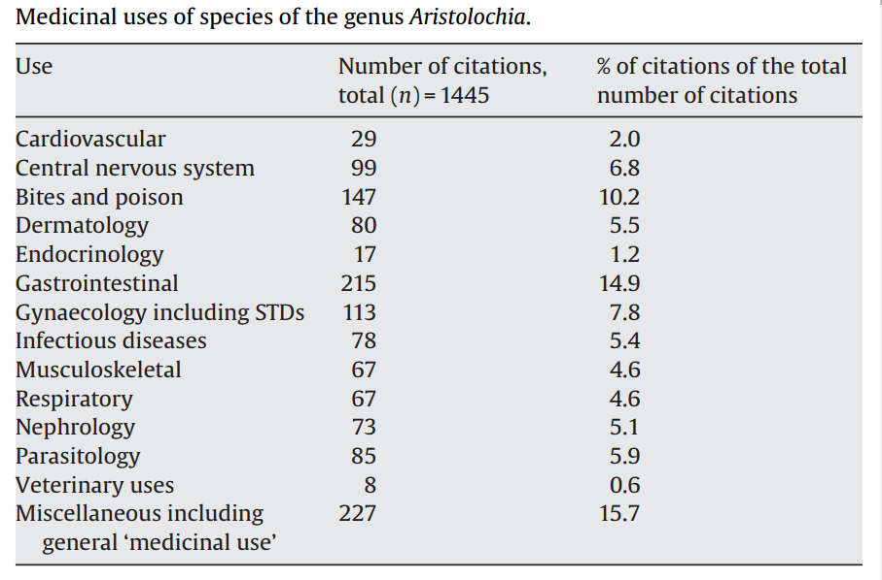
M. Heinrich et al 2009
doi:10.1016/j.jep.2009.05.028

Slide 56
Table S6. Drivers identified by MutSigCV or 20/20+ in 98 Taiwan HCCs.
Gene | Proportion of Taiwan HCCs with mutation | Classification in Cancer Gene Census | Notes | Proportion with mutations in TCGA 2017
TP53 | 0.54 | TSG | Commonly mutated in HCC | 0.31
CTNNB1 | 0.24 | oncogene | Commonly mutated in HCC | 0.27
ALB | 0.21 |  | Commonly mutated in HCC, status as driver controversial | 0.13
AXIN1 | 0.17 | TSG | Commonly mutated in HCC | 0.08
DOCK8 | 0.11 |  | Not expressed in liver or liver cancer (http://www.proteinatlas.org/ENSG00000107099-DOCK8/cancer); not observed in any other HCC genomic study | NR
BRD7 | 0.09 |  | Observed in Totoki et al., 2014 , Fujimoto et al., 2016 | NR
ARID2 | 0.09 | TSG | Observed in multiple other HCC genomic studies | 0.05
RPS6KA3 | 0.08 |  | Observed in multiple other HCC genomic studies | 0.04
IRF2 | 0.06 |  | Reported as an HCC TSG in Guichard et al., 2012 | NR
RAG1 | 0.06 |  | Activation of immunoglobulin V-D-J recombination.; not likely to have a role in hepatocytes or liver cancer | NR
RB1 | 0.06 | TSG | Observed in multiple other HCC genomic studies | 0.04
PBRM1 | 0.05 | TSG | Observed in multiple other HCC genomic studies | NR

Slide 57
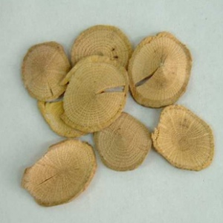
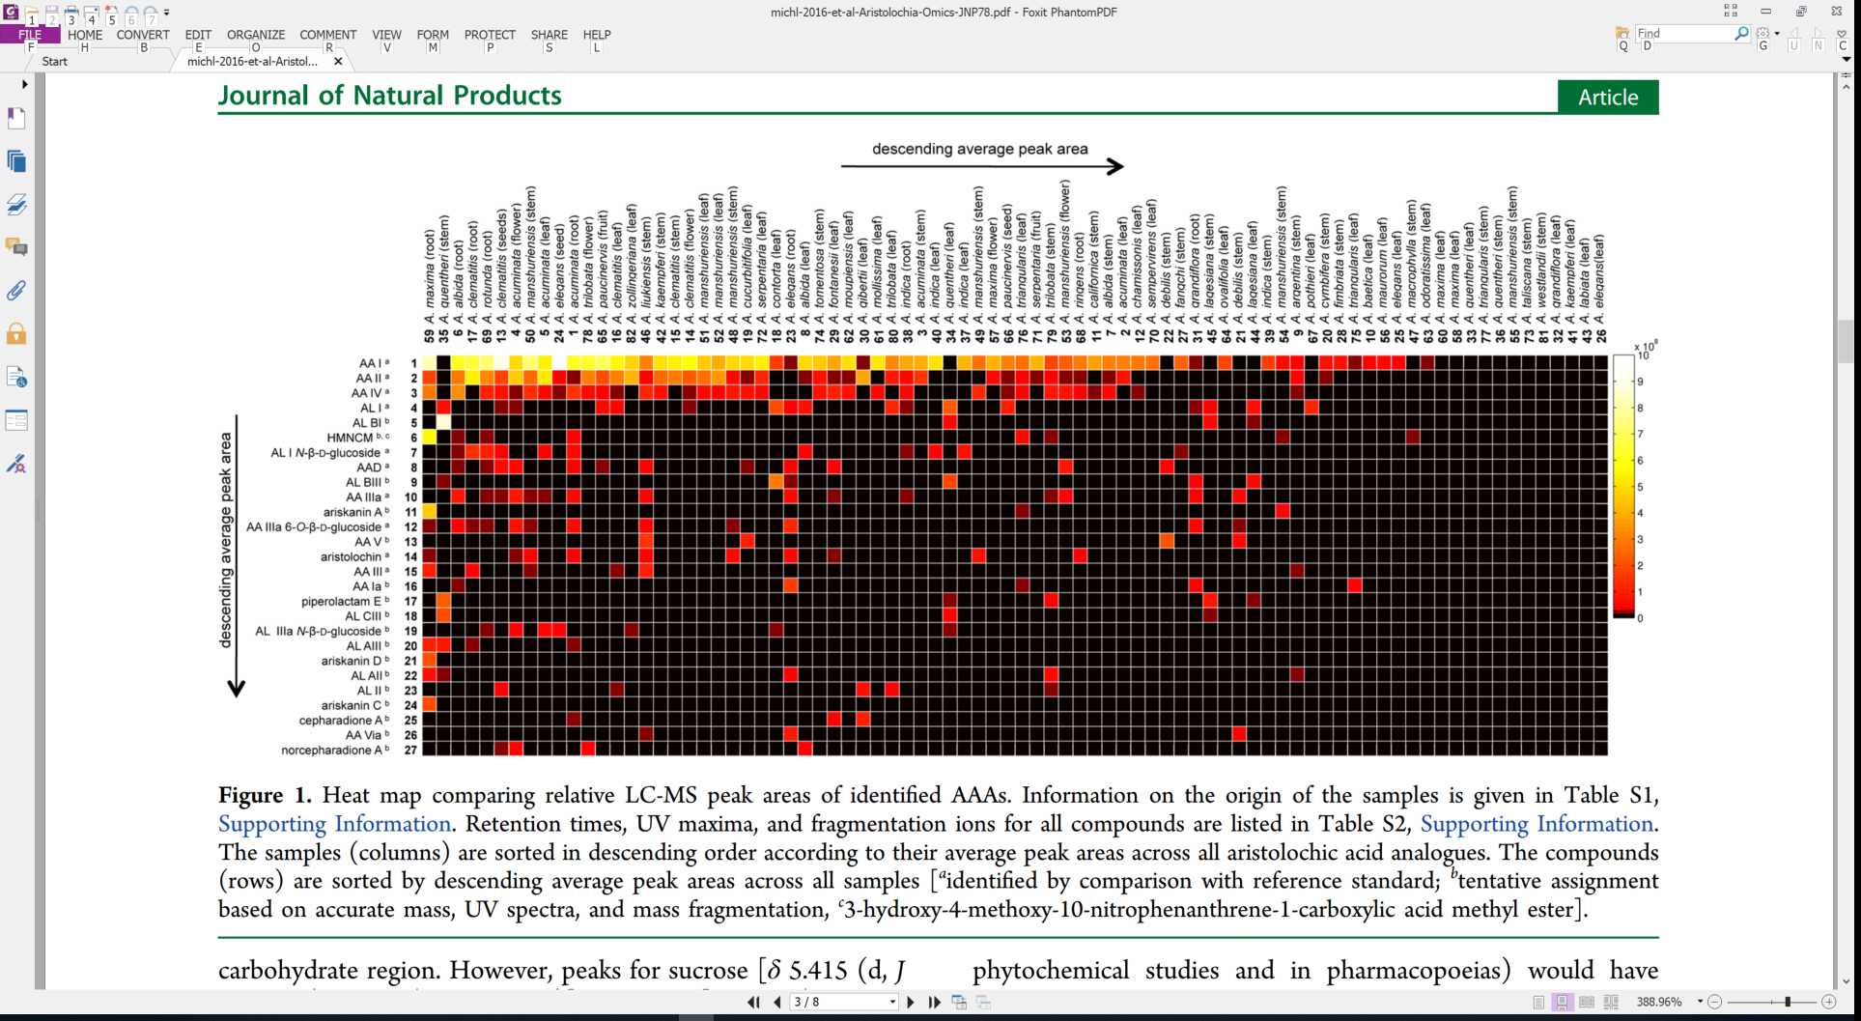
Variable and diverse AA content
Each column is a sample
关木通 guān mù tōng (stem of
Aristolochia manshuriensis)
High concentration
Each row is a different AA analog
Low concentration
Michl et al., 2015, J. Natural Products doi:10.1021/acs.jnatprod.5b00556
Notes:
https://www.e138.net/zhongyao/cai-141.html

Slide 58
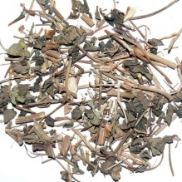
Variable and diverse AA content
Each column is a sample
天仙藤 tiān xiān téng (thin stems and leaves of Aristolochia debilis)
High concentration
Each row is a different AA analog
Low concentration
Michl et al., 2015, J. Natural Products doi:10.1021/acs.jnatprod.5b00556

Slide 59
Computational analysis of large databases
Experimental
delineation
Discovery
Mutational Signatures

Slide 60
Computational analysis of large databases
Experimental
delineation
Discovery
Mutational Signatures
Which mutational processes cause cancer?
Understanding
DNA damage &repair
Applications
External (exogenous) exposure
Cancer epidemiology
Mutations caused by endogenous processes

Slide 61
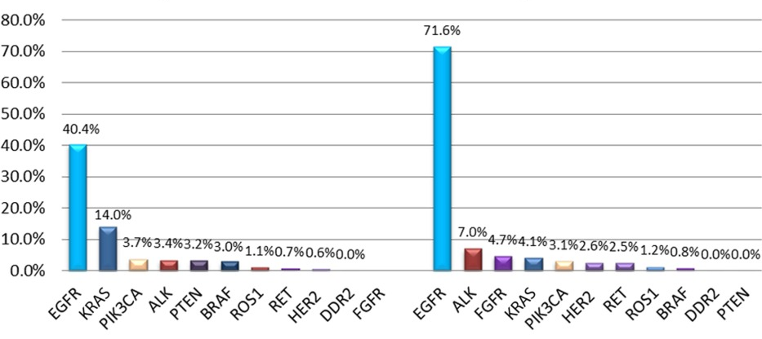
Prevalence of mutations involving oncogenes in East Asian lung adenocarcinomas
Smokers versus Non-smokers
% tumors with mutation in given oncogene
Smokers
Non-smokers
Oncogene
Gou, 2015, 10.1002/cncr.29531

Slide 62
Prevalence of mutations involving oncogenes in East Asian lung adenocarcinomas
Smokers versus Non-smokers
% tumors with mutation in given oncogene
Smokers
Non-smokers
Oncogene
Gou, 2015, 10.1002/cncr.29531

Slide 63
Prevalence of mutations involving oncogenes in East Asian lung adenocarcinomas
Smokers versus Non-smokers
% tumors with mutation in given oncogene
Smokers
Non-smokers
Oncogene
Gou, 2015, 10.1002/cncr.29531

Slide 64
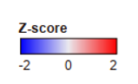
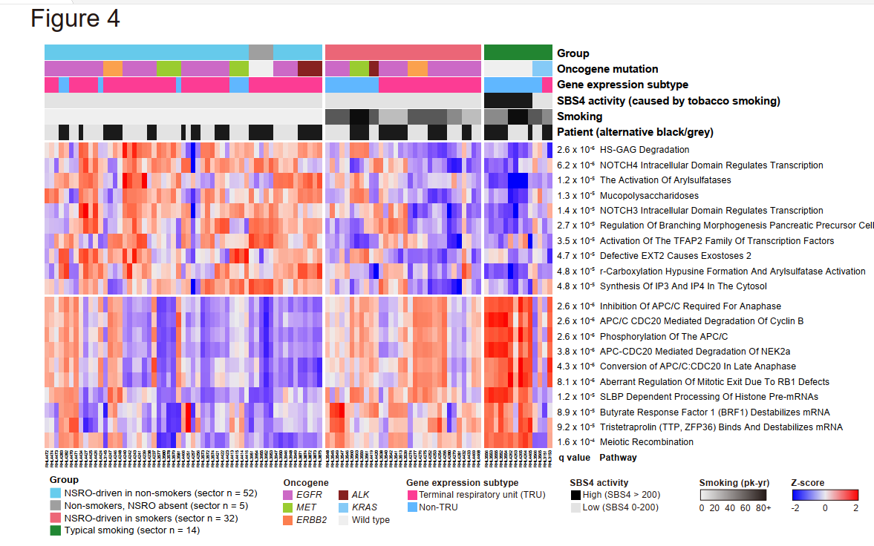
Suggestive evidence that smoking still plays a role in NSRO-driven cancers in smokers
Non-Smokers
NSRO-driven
Smokers
NSRO-driven Typical
Transcriptome differences between smokers and non-smokers regardless of NSRO status
Huang, 2023, 10.1101/2023.07.04.547310

Slide 65
2021 AA adducts and mutations in normal and other non-cancer tissue
Liver - adducts and mutational signature (Brunner et al, 2019, doi: 10.1038/s41586-019-1670-9)
Bladder and upper tract urothelia - mutational signature (Du et al., 2016; Lu et al., 2020, 10.7150/thno.43251; Li et al., 2020, 10.1126/science.aba7300)
Kidney - adducts
White blood cells - mutational signature (our unpublished results)
Notes:
Poon et al., 2013 and subsequent data (liver - hepatocellular carcinoma [HCC])
Zou et al., 2015, Jusakul et al., 2017 (bile duct carcinoma)
Scelo et al., 2014, Jelakovic et al., 2014 (kidney/renal cell carcinoma)
Poon et al., 2013, Hoang et al., 2013, many others (upper tract urothelial carcinoma)
Poon et al., 2015, others (bladder urothelial carcinoma)

